Slide 1
Theory of Elasticity in Geotechnical Engineering
Lecture
Hadush Seged (Dr.)
November 5, 2009

Slide 2
General Introduction
The subject of Elasticity:
is concerned with the determination of the stresses and displacements in a body as a result of applied loads.
a body under elastic deformation reverts to its original state on the removal of the loads.

Slide 3
in this course we will focus on linear infinitesimal elasticity.
stresses and displacements are linear with loads.
linear superposition can be used to construct solutions.

Slide 4
Why study elasticity for soils?
Soil is neither linear nor pure elastic material.
The stress-strain behavior of soils is usually found to be highly non-linear and hysteretic.
You may then ask: “why should I have to study the linear theory of elasticity in relation to soils?”
The answer is two fold.

Slide 5
Elasticity is simple & convenient tool
theory of elasticity possess long history that is distinguished not only by firm mathematical foundation but also solution of large number of useful practical problems.

Slide 6
Most soils behave like a linear elastic material at relatively small applied stresses
In many problems in foundation engineering the level of shearing stresses within the soil deposit is considerably lower than its ultimate strength.
Usually foundations are designed with factors of safety of three or more, which means the stress level in general terms is about one-third of the ultimate strength.

Slide 7
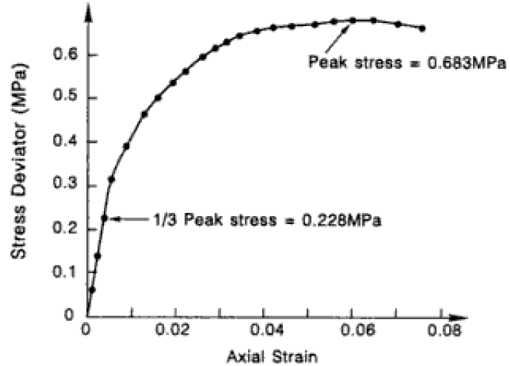
Approximately linear in this range
Typical stress – strain behavior of a fine sand

Slide 8
Therefore, for problems in which the soil is not subjected to stresses larger than about one-third of the ultimate strength, elasticity theory is not only simple & convenient but also offers a rational approximation to the load-deformation behavior we may expect.

Slide 9
Other reasons:
elastic analysis involves only two constants: Young’s Modulus E and Poisson’s ratio ν – thus if we assume soil is elastic, then we have a powerful but simple tool to predict soil behavior.
in geotechnical design, the settlement of a structure under working load should be within tolerable limits; and is preferred to be elastic so that no permanent settlement occurs. Elastic analysis is thus needed to calculate elastic settlement. .

Slide 10
even for advanced inelastic soil models that are used to describe the complexity of soil behavior, elastic analysis is the first step.
elasticity solutions will often give insight into the basic mechanics of a problem and understanding of elasticity and its use in geotechnical problems has frequently led to new and innovative solutions to old problems.
elasticity is a powerful tool in assessing the way a structure interacts with a soil (soil-structure interaction).

Slide 11
Basic Concepts of Continuum Mechanics
Definition by A.J.M. Spencer (1966):
Continuum mechanics means mechanics of continuous media, and a continuous medium is a medium which occupies every point of a continuous region of space. In continuum mechanics, we treat materials – gases, liquids, solids – as though they completely fill up the region they occupy, with no holes or gaps even if we know that this is not what materials are really like.

Slide 12
Soils are multiphase materials comprised of mineral grains, air voids and water. Hence, technically speaking a soil can never be a continuum.
Ideally, the mathematical characterization of a soil should be based on the behavior of individual constituent elements and their interaction.
However, such an approach will be rather complex and would not be fruitful in geotechnical engineering applications.

Slide 13
For any reasonable problem in geotechnical engineering the characteristic dimension or the scale of practical interest will be in the order of meters, whereas the characteristic dimension of a soil particle could range from 2μm (e.g. clay) to 50 mm (gravel) .
Thus, the microscopic effects can be averaged and the soil can be idealized as a continuum, provided that our results will only be applied to volumes sufficiently large enough to encompass significant numbers of soil particles.

Slide 14
Analysis of Stress in 3D
The analysis of stress is essentially a branch of mechanics which is concerned with the detailed description of the way in which the stress at a point of a body varies.
For 2D stress analysis, the use of Mohr’s circle is found to be most convenient. In 3D analysis, however, the use of index notation is preferred for the calculation of stresses across any plane at a point.

Slide 15
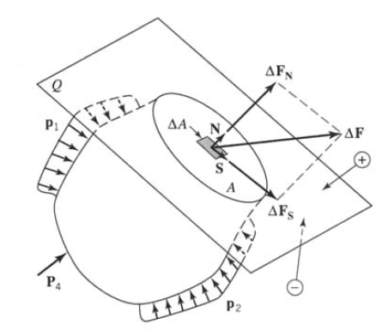
Definition of stress at a point:
A general loaded body cut by a plane Q along surface A

Slide 16
The portion of the body on one side of Q exerts a force on the portion of the body on the other side of Q.
This force is transmitted through the plane Q by direct contact of the parts of the body on the two sides of Q.
Let the force that is transmitted through an incremental area ΔA of A by the part on the one side of Q be denoted by ΔF. In accordance with Newton’s 3rd law, the portion of the body on the other side of Q transmits through area ΔA a force -ΔF .

Slide 17
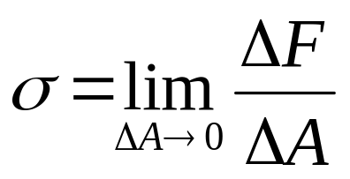
The magnitude of the average force per unit area is ΔF/ΔA and this ratio is called the average stress acting on area ΔA.
The concept of stress at a point is obtained by letting ΔA become an infinitesimal. Then the forces ΔF approaches zero, but usually the ratio ΔF/ΔA approaches a limit different from zero.
The limiting ratio of ΔF/ΔA as ΔA goes to zero defines the stress vector σ (also called traction vector T).

Slide 18
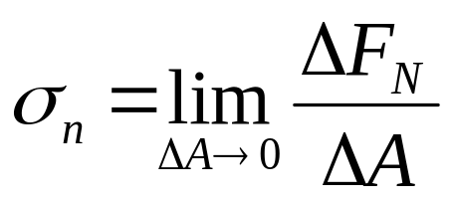
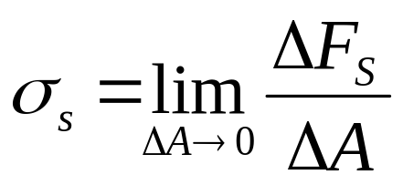
The force ΔF may be resolved into components ΔF_{N} and ΔF_{S}, along unit normal N and unit tangent S, respectively, to the plane Q.
Similar definitions for the normal stress vector and shear stress vector are given below:

Slide 19
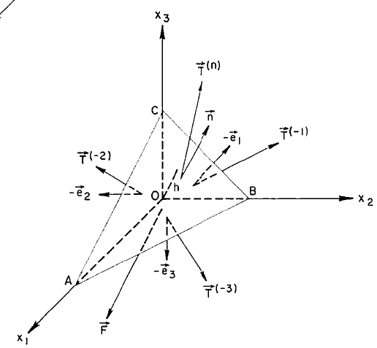
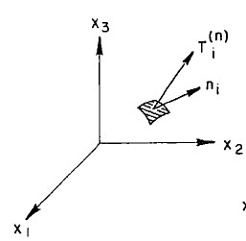
Cauchy’s formula
Relation between stress vector acting on arbitrary plane n_{i} and the three stress vectors acting on the coordinate plane

Slide 20
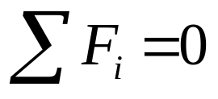
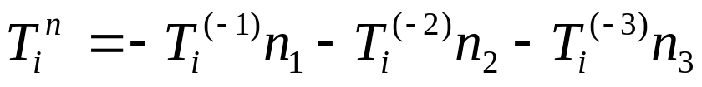
From equilibrium condition of element OABC:
…...(1.1)
Dividing eqn. (1.1) by A and letting h tend to 0, we get:
…...(1.2)
since

Slide 21
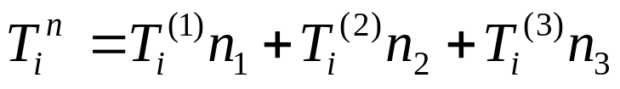
Eqn. (1.2) has, therefore, the simple form:
…...(1.3)
Eqn. (1.3) is known as Cauchy’s formula.
The stress vector T_{i}^{n} at a point is expressed as a linear combination of the three stress vectors on the plane-area elements perpendicular the three coordinates at the point.
Therefore, the three stress vectors T_{i}⁽¹⁾, T_{i}⁽²⁾,T_{i}⁽³⁾ define the state of stress at a point completely.

Slide 22
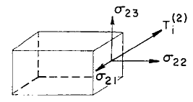
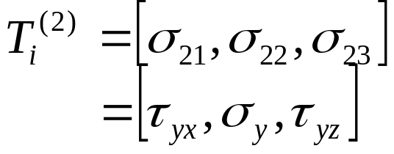
Since T_{i} is a vector quantity, it can be more conveniently represented by three components:
a normal stress and two tangential (or shear) stresses.
x₃
For example, the stress vector T_{i}⁽²⁾ associated with the coordinate plane y or x₂ has the three components:
x₂
x₁
..(4)

Slide 23
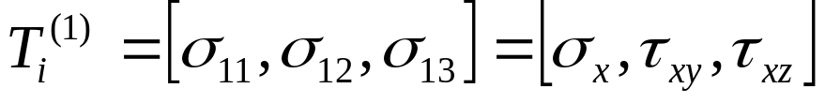
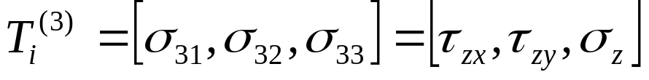
The index notation of σ₂₂ for normal stress and σ₂₁, σ₂₃ for shear stresses and the engineering notation of σ_{y} for normal stress and σ_{yx}, σ_{yz} for shear stresses are used interchangeably.
In the same way, the stress vector at a point across a plane whose normal is in the direction of x₁ has the components:
…...(1.5)
Similarily:
…...(1.6)

Slide 24
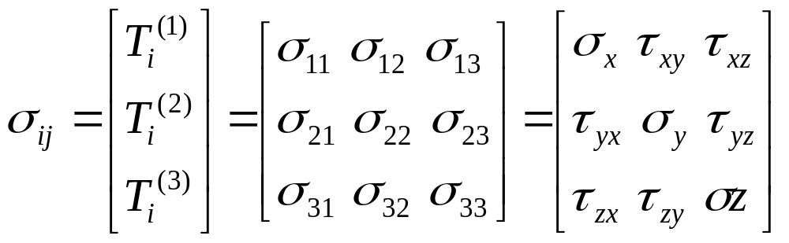
In the above notations the first suffix denotes the normal direction on the small area ΔA and the second suffix denotes the direction in which the component acts.
The nine quantities in equations (1.4) to (1.6) are called components of the stress tensor σ_{ij} at a point.
…...(1.7)

Slide 25
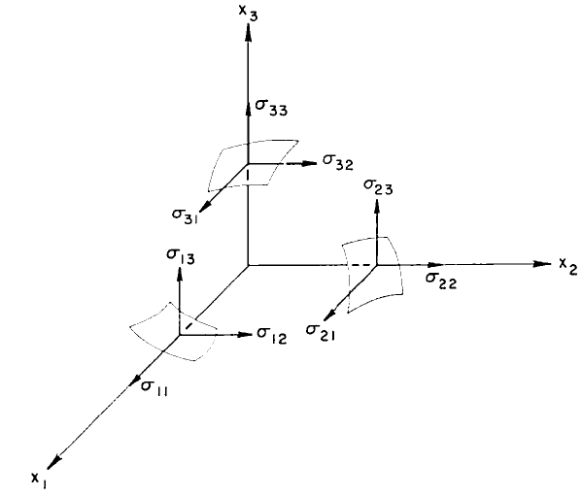
Components of stress tensor σ_{ij}

Slide 26
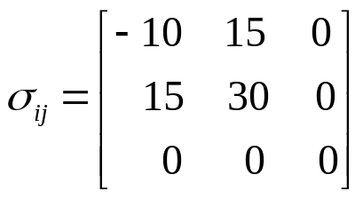

Example 1
The state of a stress at a point is represented by the given stress tensor:
For a plane with unit normal n_{i} = , calculate the magnitude of the stress (traction) vector T_{i}^{(n)}.

